Slide 1
ENSEMBLE LEARNING

Slide 2
Ensemble Learning
So far – learning methods that learn a single hypothesis, chosen from a hypothesis space that is used to make predictions.
Ensemble learning - > select a collection (ensemble) of hypothesis and combine their predictions.
Example 1 – generate 100 different decision trees from the same or different training set and have them vote on the best classification for a new example.
Key motivation: reduce the error rate. Hope is that will become much more unlikely that the ensemble will misclassify an example.

Slide 3
Learning Ensembles
Learn multiple alternative definitions of a concept using different training data or different learning algorithms.
Combine decisions of multiple definitions, e.g. using weighted voting.
Training Data
Data 1
Data 2
…..............
Data n
Learner 1
Learner 2
Learner n
Model 1
Model 2
Model n
Model Combiner
Final Model

Slide 4
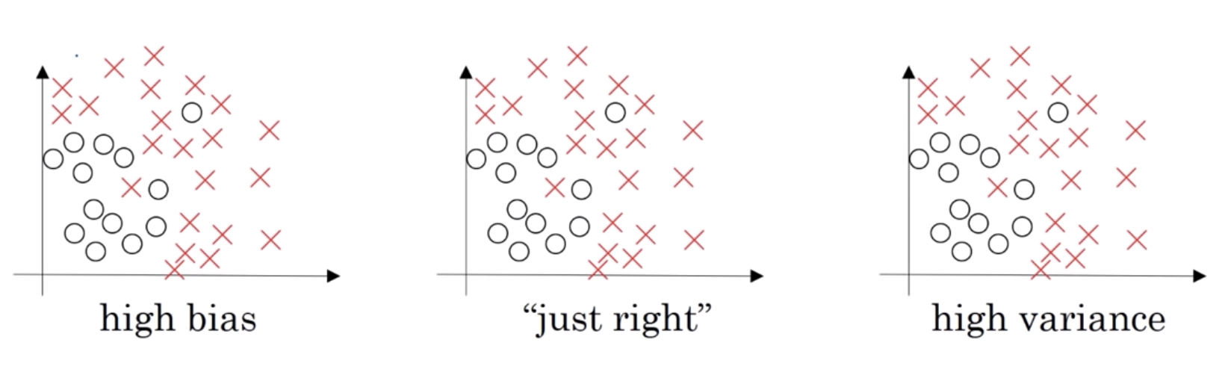
Bias Vs Variance

Slide 5
Bias Vs Variance
Lets assume we are building a model to perform binary classification.
We evaluated the model on the training and validation datasets.
Train: 1% error
Validation: 20% error
What does that tell you??

Slide 6
Bias Vs Variance
Now lets assume that we evaluated the model on the training and validation datasets with the following:
Train: 15% error
Validation: 17% error
Assuming that this task is simple, and humans would usually get 0 or 1 percent error.
What does that tell you??

Slide 7
Bias Vs Variance
Now lets assume that we evaluated the model on the training and validation datasets with the following:
Train: 30% error
Validation: 40% error
Assuming that this task is simple, and humans would usually get 0 or 1 percent error.
What does that tell you??

Slide 8
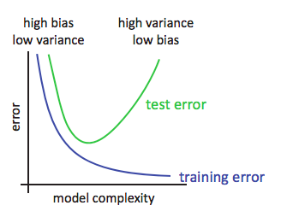
Bias vs Variance
ML balances
Estimation error (variance)
Precision of match
Sensitivity to training data
Structural error (bias)
Distance from true relationship
Goals
Reduce variance without increasing bias
Reduce bias and variance

Slide 9
Debugging High Bias/Variance
High Bias
Means the model is underfitting the data
Should try different models
High Variance
Means the model is overfitting the data
Add more data (subset is small hence the model memorizes)
Apply regularization ( a technique to improve the generalizability of a learned model.)
Evaluate model parameters

Slide 10
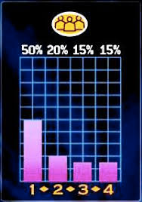
Value of Ensembles
“No Free Lunch” Theorem
No single algorithm wins all the time!
When combining multiple independent and diverse decisions each of which is at least more accurate than random guessing, random errors cancel each other out, correct decisions are reinforced.
Examples: Human ensembles are demonstrably better
Who wants to be a millionaire: Audience vote

Slide 11


Example: Weather Forecast
Reality
1
2
3
4
5
Combine

Slide 12
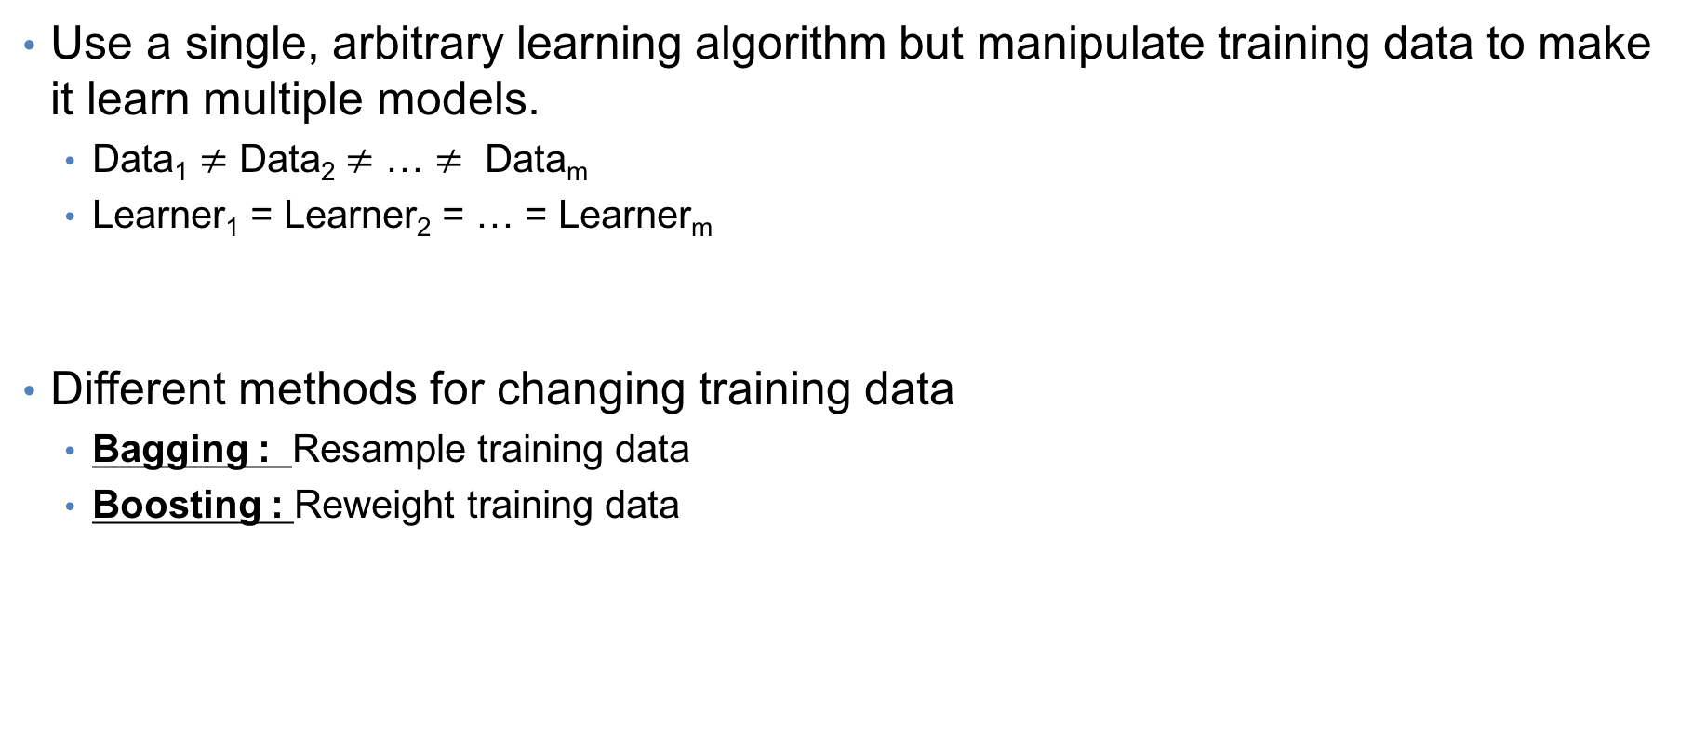
Homogenous Ensembles
https://towardsdatascience.com/ensemble-learning-using-scikit-learn-85c4531ff86a

Slide 13
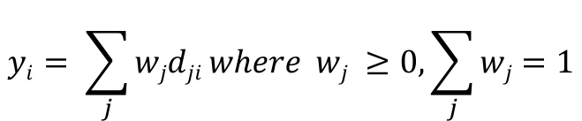
Voting
y
f()
+
Linear combination
w₁
w_{L}
w₂
d₁
d₂
d_{L}
x

Slide 14
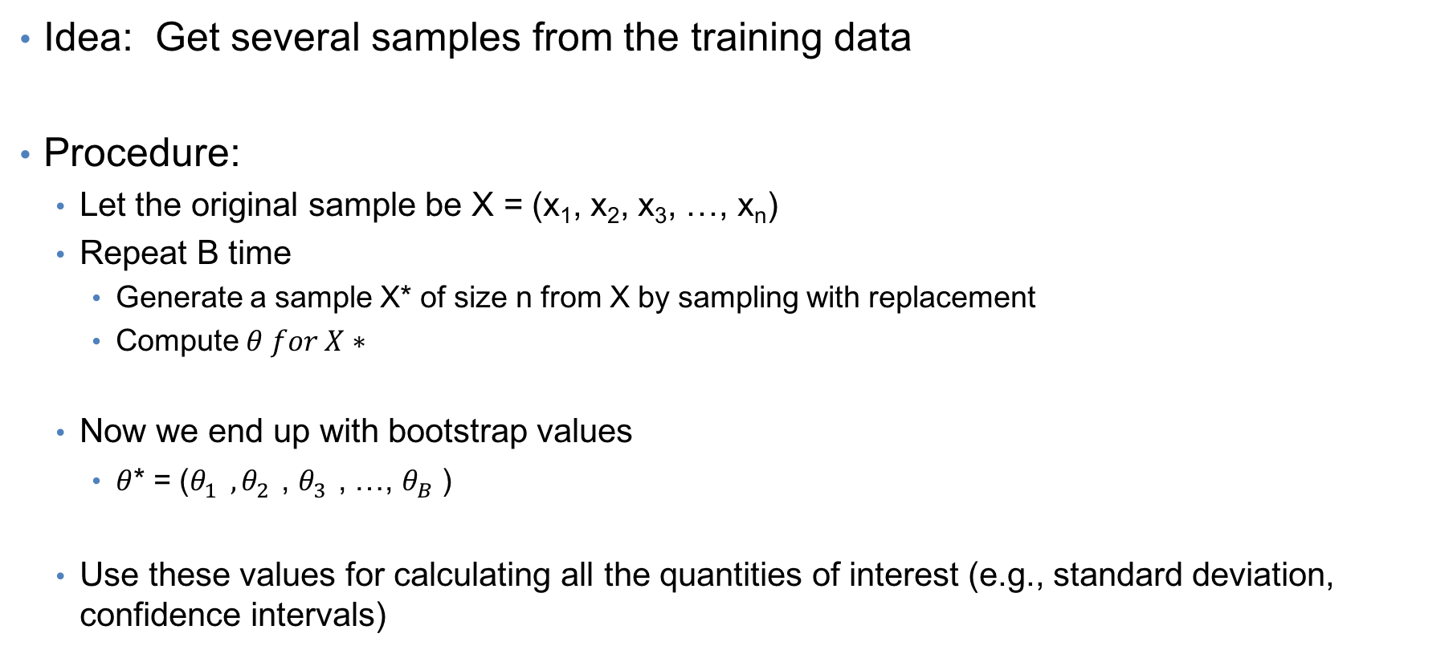
Bootstrap Resampling

Slide 15
A quick view of bootstrapping
Introduced by Bradley Efron in 1979 [PDF]
Became popular in 1980s due to the introduction of computers in statistical practice.
It has minimum assumptions. It is merely based on the assumption that the sample is a good representation of the unknown population.

Slide 16
Bagging (bootstrap + aggregating)
Bagging is a way to decrease the variance in the prediction by generating additional data for training from dataset using combinations with repetitions to produce multi-sets of the original data.
i.e. Bagging averages a noisy fitted function refit to many bootstrap samples to reduce its variance.
Use bootstrapping to generate B training sets
We draw bootstrap samples S₁, … S_{b} each of size N with replacement from the training data.
Train B base learners
During test, take the average

Slide 17
Bagging
Training
In each iteration t, t = 1, … , T
Randomly sample with replacement N samples from the training set
Train a chosen “base model” (e.g. neural network, decision tree) on the samples
Test
For each test example
Start all trained base models
Predict by combining results of all T trained models:
Regression: averaging
Classification: a majority vote

Slide 18
Boosting: Weak learner vs Strong learner
Boosting is an iterative technique which adjusts the weight of an observation based on the last classification
In boosting, we actively try to generate complementary base-learners by training the next learner on the mistakes of the previous learners.
The original boosting algorithm (Schapire 1990) combines three weak learners to generate a strong learner.
A weak learner has error probability less than ½, which makes it better than random guessing on a two-class problem.
A strong learner has arbitrarily small error probability.

Slide 19
Boosting (Alpaydin, 2012)
Given a large training set, we randomly divide it into three.
We use X1 and train classifier d1.
We then use X2 and feed it to d2.
We take all instances misclassified by d1, and also as many instanced on which d1 is correct from X2.
Then, this training data is feed-in to d2.
We then take X3 and feed it to d1 and d2.
The instances on which d1 and d2 disagree form the training set for d3.
During testing, given an instance x:
X is evaluated using d1 and d2.
If both agree on the result, it is returned immediately.
Otherwise, the response of d3 is taken as the output.

Slide 20
Boosting: drawback
Though it is quite successful, the disadvantage of the original boosting method is that it requires a very large training sample.

Slide 21
Adaboost (adaptive boosting)
Use the same training set over and over and thus need not be large.
Classifiers must be simple so they do not over-fit.
Can combine an arbitrary number of base learners, not only three.
https://scikit-learn.org/stable/modules/generated/sklearn.ensemble.AdaBoostClassifier.html

Slide 22
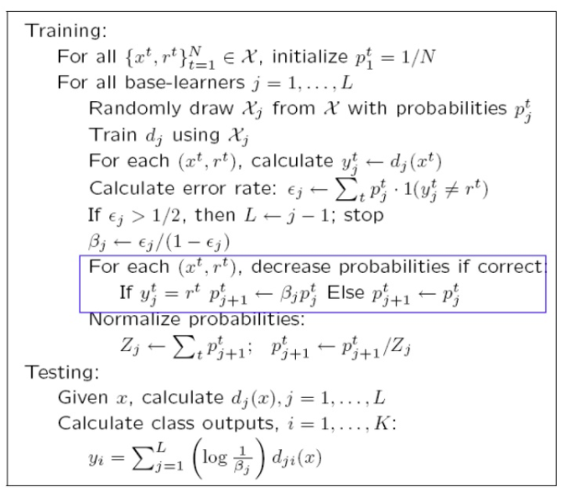
AdaBoost
The output of the other learning algorithms ('weak learners') is combined into a weighted sum that represents the final output of the boosted classifier.
The probability of a correctly classified instance is decreased, and the probability of a misclassified instance increases. This has the effect that the next classifier focuses more on instances misclassified by the previous classifier.

Slide 23
Adaboost: Testing
Given an instance, all the classifiers decide and a weighted vote is taken.
The weights are proportional to the base learner’s accuracies on the training set.
The success of Adaboost is due to its property of increasing the margin. If the margin increases, the training instances are better separated and error are less likely.

Slide 24
Summary
It is often a good idea to combine several learning methods.
We want diverse classifiers, so their errors cancel out.
However, remember, ensemble methods do not get a free lunch …
Readings
Dietterich (2000) : [PDF]
Alpaydin (2010) : Ch 17 [PDF]
Daume (2012) : Ch 11 [PDF]

Slide 26
RANDOM FOREST

Slide 27
Definition
Random forest (or random forests) is an ensemble classifier that consists of many decision trees and outputs the class that is the mode of the class's output by individual trees.
The term came from random decision forests that was first proposed by Tin Kam Ho of Bell Labs in 1995.
The method combines Breiman's "bagging" idea and the random selection of features.

Slide 28
Decision trees
Decision trees are individual learners that are combined. They are one of the most popular learning methods commonly used for data exploration.
One type of decision tree is called CART… classification and regression tree.
CART … greedy, top-down binary, recursive partitioning, that divides feature space into sets of disjoint rectangular regions.
Regions should be pure wrt response variable
Simple model is fit in each region – majority vote for classification, constant value for regression.

Slide 29
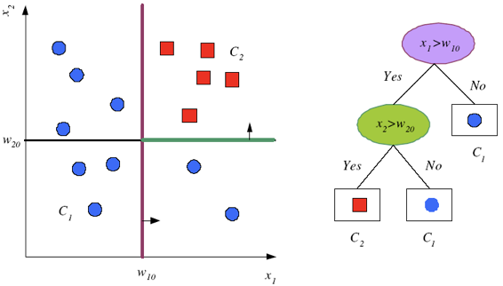
Decision trees

Slide 30
Decision trees
Internal decision nodes
Univariate: Uses a single attribute, x_{i}
Numeric x_{i} : Binary split : x_{i} > w_{m}
Discrete x_{i} : n-way split for n possible values
Multivariate: Uses all attributes, x
Leaves
Classification: Class labels, or proportions
Regression: Numeric; r average, or local fit
Learning is greedy; find the best split recursively (Breiman et al, 1984; Quinlan, 1986, 1993) without backtracking (decision taken are final)

Slide 31
Algorithm
Each tree is constructed using the following algorithm:
Let the number of training cases be N, and the number of variables in the classifier be M.
We are told the number m of input variables to be used to determine the decision at a node of the tree; m should be much less than M.
Choose a training set for this tree by choosing n times with replacement from all N available training cases (i.e. take a bootstrap sample). Use the rest of the cases to estimate the error of the tree, by predicting their classes.
For each node of the tree, randomly choose m variables on which to base the decision at that node. Calculate the best split based on these m variables in the training set.
Each tree is fully grown and not pruned (as may be done in constructing a normal tree classifier).
For prediction a new sample is pushed down the tree. It is assigned the label of the training sample in the terminal node it ends up in. This procedure is iterated over all trees in the ensemble, and the average vote of all trees is reported as random forest prediction.

Slide 32
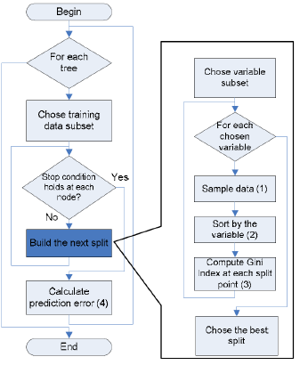
Algorithm flow chart
For computer scientists:

Slide 33
Random Forest – practical consideration
Splits are chosen according to a purity measure:
E.g. squared error (regression), Gini index or devinace (classification)
How to select N?
Build trees until the error no longer decreases
How to select M?
Try to recommend defaults, half of them and twice of them and pick the best.

Slide 34
Features and Advantages
The advantages of random forest are:
It is one of the most accurate learning algorithms available. For many data sets, it produces a highly accurate classifier.
It runs efficiently on large databases.
It can handle thousands of input variables without variable deletion.
It gives estimates of what variables are important in the classification.
It generates an internal unbiased estimate of the generalization error as the forest building progresses.
It has an effective method for estimating missing data and maintains accuracy when a large proportion of the data are missing.

Slide 35
Features and Advantages
It has methods for balancing error in class population unbalanced data sets.
Generated forests can be saved for future use on other data.
Prototypes are computed that give information about the relation between the variables and the classification.
It computes proximities between pairs of cases that can be used in clustering, locating outliers, or (by scaling) give interesting views of the data.
The capabilities of the above can be extended to unlabeled data, leading to unsupervised clustering, data views and outlier detection.
It offers an experimental method for detecting variable interactions.

Slide 36
Disadvantages
Random forests have been observed to overfit for some datasets with noisy classification/regression tasks.
For data including categorical variables with different number of levels, random forests are biased in favor of those attributes with more levels. Therefore, the variable importance scores from random forest are not reliable for this type of data.

Slide 37
RM - Additional information
Estimating the test error:
While growing forest, estimate test error from training samples
For each tree grown, 33-36% of samples are not selected in bootstrap, called out of bootstrap (OOB) samples
Using OOB samples as input to the corresponding tree, predictions are made as if they were novel test samples
Through book-keeping, majority vote (classification), average (regression) is computed for all OOB samples from all trees.
Such estimated test error is very accurate in practice, with reasonable N

Slide 38
RM - Additional information
Estimating the importance of each predictor:
Denote by ê the OOB estimate of the loss when using original training set, D.
For each predictor xp where p∈{1,..,k}
Randomly permute pth predictor to generate a new set of samples D' ={(y1,x'1),…,(yN,x'N)}
Compute OOB estimate êk of prediction error with the new samples
A measure of importance of predictor xp is êk – ê, the increase in error due to random perturbation of pth predictor

Slide 39
Conclusions & summary:
Fast fast fast!
RF is fast to build. Even faster to predict!
Practically speaking, not requiring cross-validation alone for model selection significantly speeds training by 10x-100x or more.
Fully parallelizable … to go even faster!
Automatic predictor selection from large number of candidates
Resistance to over training
Ability to handle data without preprocessing
data does not need to be rescaled, transformed, or modified
resistant to outliers
automatic handling of missing values
Cluster identification can be used to generate tree-based clusters through sample proximity

